Slide 1
Jumper Man

Slide 2

Scene 1
History
SKIP

Slide 3


Scene 2
Menu
start
options
exit

Slide 4
Scene 3
Game control
=right shift
=left shift
= jump
= pause
||

Slide 5
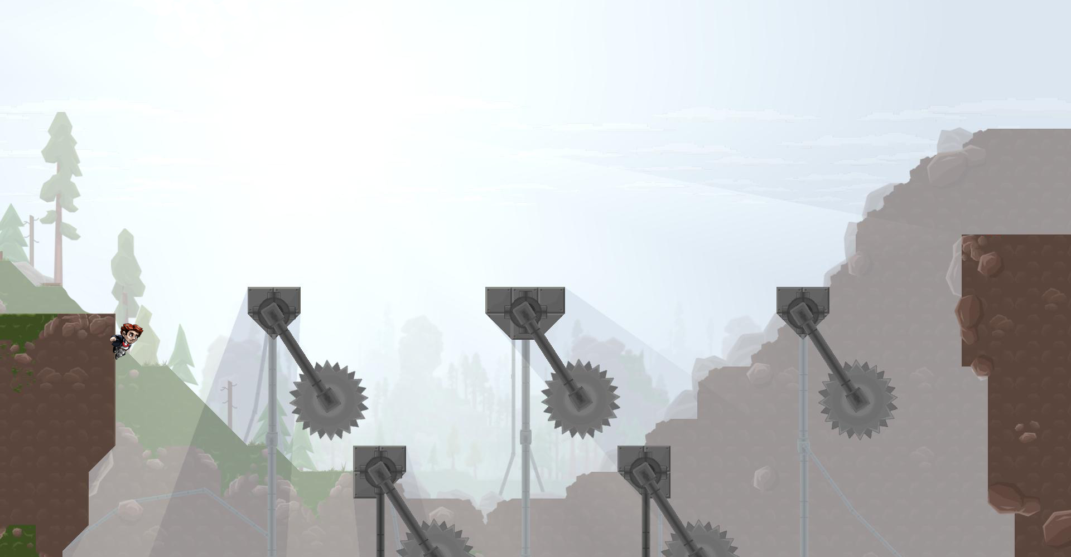
Scene 4
Game
||
key 0 : 1
Time 00:00:00

